Slide 1
Simple Linear Regression

Slide 2
Introduction
We will examine the relationship between quantitative variables x and y via a mathematical equation.
The motivation for using the technique:
  Forecast the value of a dependent variable (y) from the value of independent variables (x₁, x₂,…x_{k}.).
  Analyze the specific relationships between the independent variables and the dependent variable.

Slide 3
The Model
The model has a deterministic and a probabilistic components
House
Cost
Building a house costs about
$75 per square foot.
House cost = 25000 + 75(Size)
Most lots sell
for $25,000
House size

Slide 4
The Model
However, house cost vary even among same size houses!
Since cost behave unpredictably,
we add a random component.
House
Cost
Most lots sell
for $25,000
House cost = 25000 + 75(Size)
+ ε
House size

Slide 5
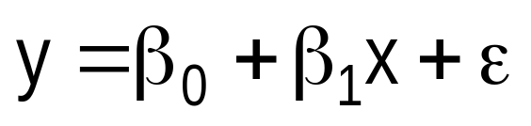
The Model
The first order linear model
  y = dependent variable
  x = independent variable
  β₀ = y-intercept
  β₁ = slope of the line
  ε = error variable
β₀ and β₁ are unknown population
parameters, therefore are estimated
from the data.
y
Rise
β₁ = Rise/Run
β₀
Run
x

Slide 6
Estimating the Coefficients
The estimates are determined by
  drawing a sample from the population of interest,
  calculating sample statistics.
  producing a straight line that cuts into the data.
y
⬥
Question: What should be
considered a good line?
⬥
⬥
⬥
⬥
          
⬥
  
   
⬥
x

Slide 7
The Least Squares (Regression) Line
A good line is one that minimizes
the sum of squared differences between the
points and the line.

Slide 8
The Least Squares (Regression) Line
Sum of squared differences =
(2 - 1)² +
(4 - 2)² +
(1.5 - 3)² +
(3.2 - 4)² = 6.89
Sum of squared differences =
(2 -2.5)² +
(4 - 2.5)² +
(1.5 - 2.5)² +
(3.2 - 2.5)² = 3.99
Let us compare two lines
4
(2,4)
⬥
The second line is horizontal
3
⬥
(4,3.2)
2.5
2
⬥
(1,2)
(3,1.5)
⬥
The smaller the sum of
squared differences
the better the fit of the
line to the data.
1
1
2
3
4

Slide 9
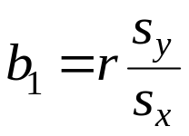
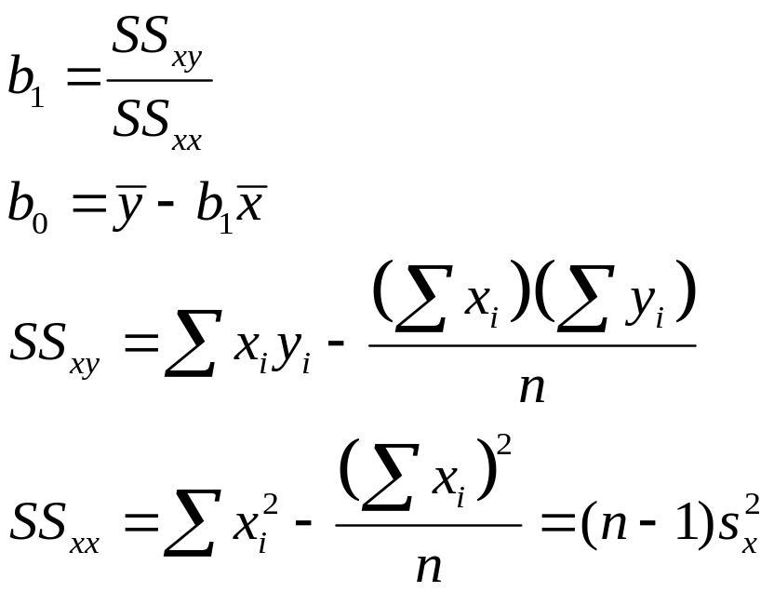
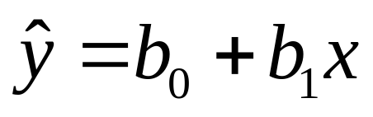
The Estimated Coefficients
Alternate formula for the slope b₁
To calculate the estimates of the slope and intercept of the least squares line , use the formulas:
The regression equation that estimates
the equation of the first order linear model
is:

Slide 10
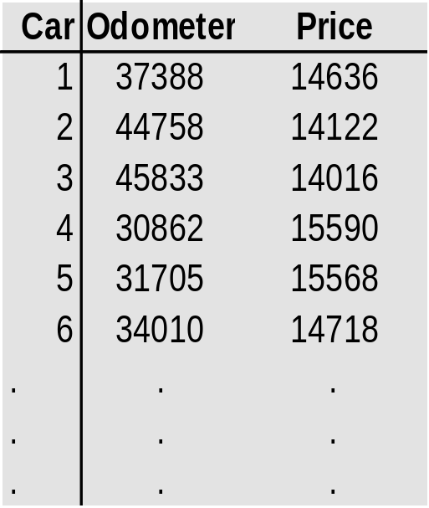
Example:
The Simple Linear Regression Line
  A car dealer wants to find
  the relationship between
  the odometer reading and
  the selling price of used cars.
  A random sample of 100 cars is selected, and the data
  recorded.
  Find the regression line.
Independent
variable x
Dependent
variable y

Slide 11
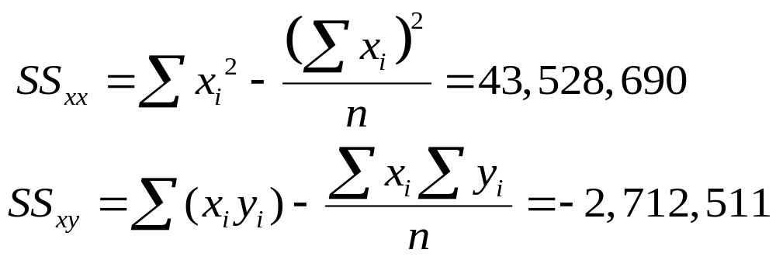
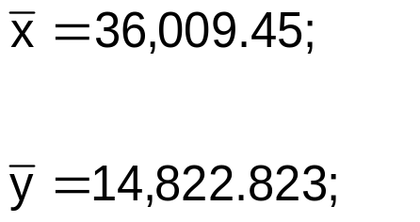
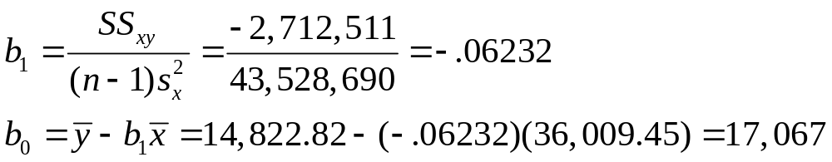
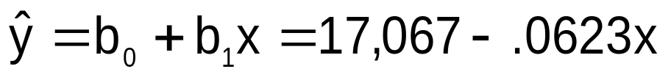
The Simple Linear Regression Line
Solution
  Solving by hand: Calculate a number of statistics
where n = 100.

Slide 12
The Simple Linear Regression Line
Solution – continued
  Using the computer
1. Scatterplot
2. Trend function
3. Tools > Data Analysis > Regression

Slide 13
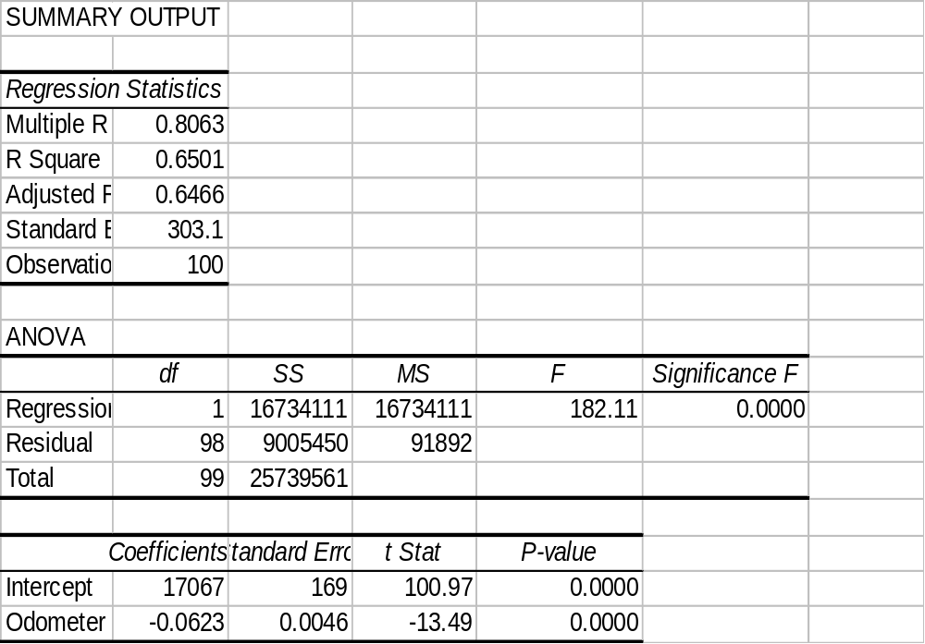

The Simple Linear Regression Line

Slide 14
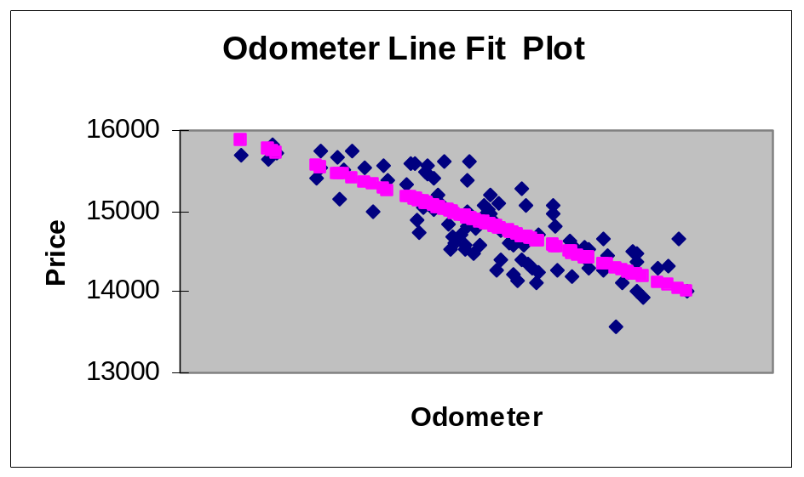

Interpreting the Linear Regression -Equation
17067
0
No data
The intercept is b₀ = $17067.
This is the slope of the line.
For each additional mile on the odometer,
the price decreases by an average of $0.0623
Do not interpret the intercept as the
“Price of cars that have not been driven”

Slide 15
Error Variable: Required Conditions
The error ε is a critical part of the regression model.
Four requirements involving the distribution of ε must be satisfied.
  The probability distribution of ε is normal.
  The mean of ε is zero: E(ε) = 0.
  The standard deviation of ε is σ_{ε} for all values of x.
  The set of errors associated with different values of y are all independent.

Slide 16
The Normality of ε
E(y|x₃)
The standard deviation remains constant,
β₀ + β₁x₃
μ₃
E(y|x₂)
β₀ + β₁x₂
μ₂
but the mean value changes with x
E(y|x₁)
β₀ + β₁x₁
μ₁
From the first three assumptions we have:
y is normally distributed with mean
E(y) = β₀ + β₁x, and a constant standard deviation σ_{ε}
x₁
x₂
x₃

Slide 17
Assessing the Model
The least squares method will produces a regression line whether or not there is a linear relationship between x and y.
Consequently, it is important to assess how well the linear model fits the data.
Several methods are used to assess the model. All are based on the sum of squares for errors, SSE.

Slide 18
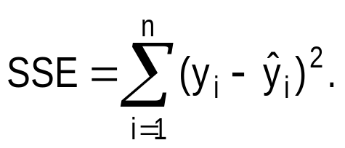
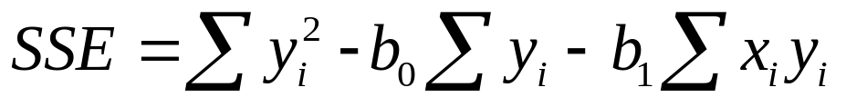
Sum of Squares for Errors
  This is the sum of differences between the points and the regression line.
  It can serve as a measure of how well the line fits the data. SSE is defined by
  A shortcut formula

Slide 19
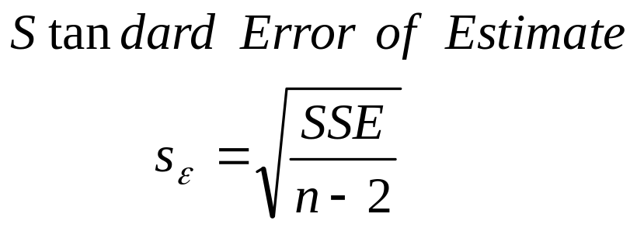
Standard Error of Estimate
  The mean error is equal to zero.
  If σ_{ε} is small the errors tend to be close to zero (close to the mean error). Then, the model fits the data well.
  Therefore, we can, use σ_{ε} as a measure of the suitability of using a linear model.
  An estimator of σ_{ε} is given by s_{ε}

Slide 20
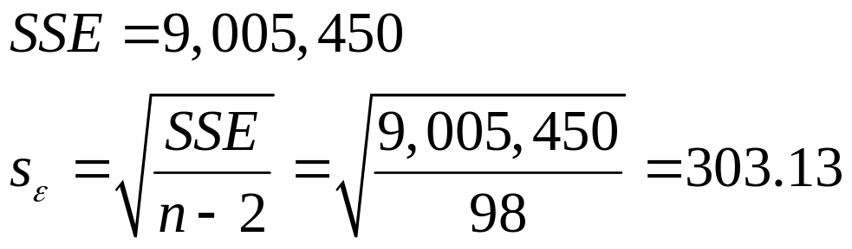

Standard Error of Estimate,
Example
Example:
  Calculate the standard error of estimate for the previous example and describe what it tells you about the model fit.
Solution
It is hard to assess the model based
on s_{ε} even when compared with the
mean value of y.

Slide 21
Testing the slope
  When no linear relationship exists between two variables, the regression line should be horizontal.
❑
❑
❑
❑
❑
❑
❑
❑
❑
❑
❑
❑
❑
❑
❑
❑
❑
❑
❑
❑
❑
❑
❑
❑
❑
❑
❑
❑
❑
❑
❑
❑
❑
❑
❑
❑
❑
❑
❑
❑
❑
❑
❑
❑
❑
❑
❑
❑
❑
❑
❑
❑
❑
❑
❑
❑
❑
❑
❑
❑
❑
❑
❑
❑
❑
❑
❑
❑
❑
❑
❑
❑
❑
❑
❑
❑
❑
❑
❑
❑
❑
❑
❑
❑
❑
❑
❑
❑
❑
❑
❑
❑
❑
❑
❑
❑
❑
❑
❑
❑
❑
❑
❑
❑
❑
❑
❑
❑
❑
❑
❑
❑
Linear relationship.
Linear relationship.
Linear relationship.
Linear relationship.
No linear relationship.
Different inputs (x) yield
the same output (y).
Different inputs (x) yield
different outputs (y).
The slope is not equal to zero
The slope is equal to zero

Slide 22
THANK YOU

